Slide 1

COMP41720
Distributed Systems: Actor Programming

Slide 2

Core Topics Covered
Actor Programing
Akka

Slide 3
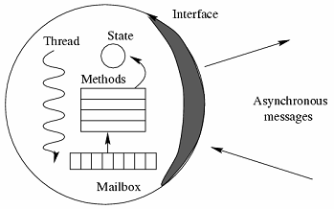
What is Actor Programming?
Actor Programming
Message-Oriented Concurrent Programming Model
Key Principles
Asynchronous Communication
Stateful & Isolated
Location Independent
Atomic message processing:
Update state / internal action
Send Messages
Create more Actors
Built-in failure handling

Slide 4
Actor Supervision
The supervisor of an actor is the actor that created it
Actors are created to delegate tasks to a subordinate.
Supervisors play a key role in failure handling…
When an actor fails (throws an exception):
it suspends itself and all its children
it notifies its supervisor of the failure.
The supervisor chooses how to respond to the failure:
resume the actor (and its children);
restart the actor (deleting its memory) and its children;
terminate the actor and its children or
failing itself.
Supervisor
Worker 1
Worker 2
Worker 3
Worker 4
Worker 5

Slide 5
Actor Supervision
The supervisor of an actor is the actor that created it
Actors are created to delegate tasks to a subordinate.
Supervisors play a key role in failure handling…
When an actor fails (throws an exception):
it suspends itself and all its children
it notifies its supervisor of the failure.
The supervisor chooses how to respond to the failure:
resume the actor (and its children);
restart the actor (deleting its memory) and its children;
terminate the actor and its children or
failing itself.
Supervisor
Worker 1
Worker 2
Worker 3
Worker 4
Worker 5

Slide 6
Actor Supervision
The supervisor of an actor is the actor that created it
Actors are created to delegate tasks to a subordinate.
Supervisors play a key role in failure handling…
When an actor fails (throws an exception):
it suspends itself and all its children
it notifies its supervisor of the failure.
The supervisor chooses how to respond to the failure:
resume the actor (and its children);
restart the actor (deleting its memory) and its children;
terminate the actor and its children or
failing itself.
Supervisor
Worker 1
Worker 2
Worker 3
notify
Worker 4
Worker 5

Slide 7
Actor Supervision
The supervisor of an actor is the actor that created it
Actors are created to delegate tasks to a subordinate.
Supervisors play a key role in failure handling…
When an actor fails (throws an exception):
it suspends itself and all its children
it notifies its supervisor of the failure.
The supervisor chooses how to respond to the failure:
resume the actor (and its children);
restart the actor (deleting its memory) and its children;
terminate the actor and its children or
failing itself.
Supervisor
Worker 1
Worker 2
Worker 3
resume
Worker 4
Worker 5

Slide 8
Actor Supervision
The supervisor of an actor is the actor that created it
Actors are created to delegate tasks to a subordinate.
Supervisors play a key role in failure handling…
When an actor fails (throws an exception):
it suspends itself and all its children
it notifies its supervisor of the failure.
The supervisor chooses how to respond to the failure:
resume the actor (and its children);
restart the actor (deleting its memory) and its children;
terminate the actor and its children or
failing itself.
Supervisor
Worker 1
Worker 2
Worker 3
restart
Worker 4
Worker 5

Slide 9
Actor Supervision
The supervisor of an actor is the actor that created it
Actors are created to delegate tasks to a subordinate.
Supervisors play a key role in failure handling…
When an actor fails (throws an exception):
it suspends itself and all its children
it notifies its supervisor of the failure.
The supervisor chooses how to respond to the failure:
resume the actor (and its children);
restart the actor (deleting its memory) and its children;
terminate the actor and its children or
failing itself.
Supervisor
Worker 1
Worker 2
Worker 3
terminate
Worker 4
Worker 5

Slide 10
Actor Supervision
The supervisor of an actor is the actor that created it
Actors are created to delegate tasks to a subordinate.
Supervisors play a key role in failure handling…
When an actor fails (throws an exception):
it suspends itself and all its children
it notifies its supervisor of the failure.
The supervisor chooses how to respond to the failure:
resume the actor (and its children);
restart the actor (deleting its memory) and its children;
terminate the actor and its children or
failing itself.
Supervisor
notify
Worker 1
Worker 2
Worker 3
Worker 4
Worker 5

Slide 11
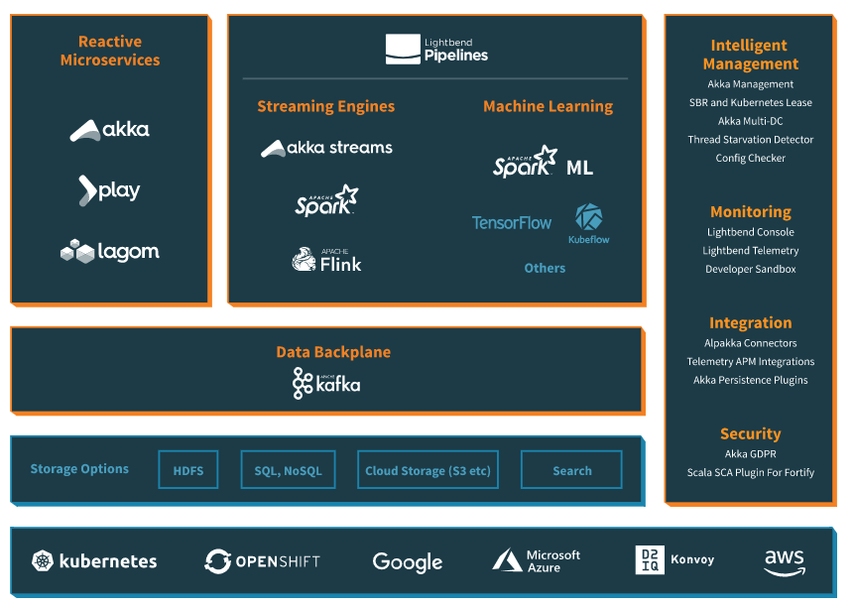
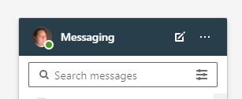
Akka & Actor Programming
Akka is an implementation of the Actor Model.
Created by Jonás Boner (CTO & Founder of Lightbend)
Inspired by Erlang; built for Scala (Martin Odersky is a co-founder)
Core part of the Lightbend technology stack…
http://lightbend.com
Initially released in 2010
Can also program Akka Actors in Java.
Has seen extensive commercial use
Presence indicator on Linked-in

Slide 12


Lightbend Customers (https://www.lightbend.com/customers)

Slide 13
Implementing an Akka Actor
Easy to implement:
Extend the AbstractActor class.
Implement the createReceive() method.
To send a message:
getSender().tell(<message>, getSelf());
To create a child actor:
context.actorOf(
Props.create(Child.class),
"Child");
public class Hello extends AbstractActor {
@Override
public Receive createReceive() {
return receiveBuilder()
.match(HelloMessage.class,
msg -> {
System.out.println("Hello World");
})
.build();
}
}
public class HelloMessage { }

Slide 14
Deploying an Akka Actor
public class HelloApp {
public static void main(String[] args) {
ActorSystem system = ActorSystem.create("ContentSystem");
final ActorRef hello = system.actorOf( Props.create(Hello.class), “hello“ );
hello.tell(new HelloMessage(), null);
}
}

Slide 15
Akka Failure Handling https://doc.akka.io/docs/akka/current/fault-tolerance.html
Actors supervise their children
The default strategy is to restart children that suffer from an Exception exception or to escalate children that suffer from a Throwable exception.
This can be overridden by defining a SupervisorStrategy within an actor implementation.
private static SupervisorStrategy strategy =
new OneForOneStrategy(
10,
Duration.ofMinutes(1),
DeciderBuilder
.match(ArithmeticException.class, e -> SupervisorStrategy.resume())
.match(NullPointerException.class, e -> SupervisorStrategy.restart())
.match(IllegalArgumentException.class, e -> SupervisorStrategy.stop())
.matchAny(o -> SupervisorStrategy.escalate())
.build());
@Override public SupervisorStrategy supervisorStrategy() { return strategy; }

Slide 16
Akka Unit Testing https://doc.akka.io/docs/akka/current/typed/testing.html
Akka Unit testing builds on Junit via the TestKit class
Implements a wrapper around a purpose build actor.
Provides methods to check assertions relevant to actor programming:
Guarantees that a given message will be received.
Guarantees upper bound time constraints on the receipt of a message
Guarantees around message ordering in protocols
<!-- Akka Unit Testing -->
<dependency>
<groupId>com.typesafe.akka</groupId>
<artifactId>akka-testkit_2.12</artifactId>
<version>2.6.0-M8</version>
<scope>test</scope>
</dependency>
<!-- Junit -->
<dependency>
<groupId>junit</groupId>
<artifactId>junit</artifactId>
<version>4.12</version>
</dependency>

Slide 17
Example: Guaranteed Time-Constrained Response
public class MyTests {
static ActorSystem system;
@BeforeClass public static void setup() {system = ActorSystem.create(); }
@AfterClass public static void teardown() { TestKit.shutdownActorSystem(system); system = null; }
@Test public void helloTest() {
final Props props = Props.create(Hello.class);
final ActorRef subject = system.actorOf(props);
final TestKit probe = new TestKit(system);
subject.tell(new HelloMessage(), probe.getRef());
probe.expectMsg(Duration.ofSeconds(2), null);
}
}

Slide 18
Akka and Distribution
Distributed Services & Akka
Akka HTTP: https://doc.akka.io/docs/akka-http/current/ Places Akka Actors behind a REST (Web) API that is implemented as a special kind of actor. This actor includes the basic capabilities to transform HTTP Requests into Akka messages that can be sent as normal and has an inbox that can receive Akka messages which it can transform back into a HTTP Response. The actor implementation uses a template that simplifies the creation of such agents.
Akka gRPC: https://doc.akka.io/docs/akka-grpc/current/ The same thing but for gRPC
Distributed Applications
Akka Clustering: https://doc.akka.io/docs/akka/current/typed/index-cluster.html A highly fault-tolerant clustering infrastructure that helps you build distributed applications.

Slide 19
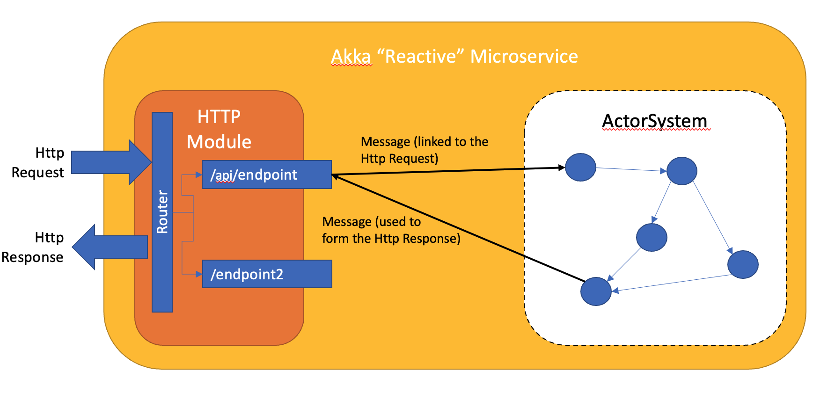
Akka Http Module https://doc.akka.io/docs/akka-http/current
A Library for implementing REST APIs
Again, a wrapper around a purpose build actor.
<!-- Akka HTTP -->
<dependency>
<groupId>com.typesafe.akka</groupId>
<artifactId>akka_http_2.12</artifactId>
<version>2.6.0-M8</version>
<scope>test</scope>
</dependency>
Described in Actor Programming Lesson!

Slide 20
Example: Pub-Sub

Slide 21
Example: Pub-Sub
Pub-Sub is an actor implementation of the standard broker pattern using an actor-in-the-middle…
A
Broker
B

Slide 22
Example: Pub-Sub
B subscribes
B receives an Init(X) message, where X is the Broker address
A
Broker
B
Behaviours:
Y, Init(X) -> Sub, X

Slide 23
Example: Pub-Sub
B subscribes
B sends a Sub message to X and X stores B’s address
A
Broker
B
Behaviours:
Y, Sub -> _Store(Y)
Behaviours:
Y, Init(X) -> Sub, X

Slide 24
Example: Pub-Sub
A publishes
A receives an Init(X, Z) message, where X is the broker and Z is some information.
A
Broker
B
Behaviours:
Y,Init(X, Z)->Pub(Z),X
Behaviours:
Y, Sub -> _Store(Y)
Behaviours:
Y, Init(X) -> Sub, X

Slide 25
Example: Pub-Sub
A publishes
A sends the information Z to X.
A
Broker
B
Behaviours:
Y,Init(X, Z)->Pub(Z),X
Behaviours:
Y, Sub -> _Store(Y)
Behaviours:
Y, Init(X) -> Sub, X

Slide 26
Example: Pub-Sub
Broker forwards
Broker receives Pub(Z) message from A…
A
Broker
B
Behaviours:
Y,Init(X, Z)->Pub(Z),X
Behaviours:
Y, Sub -> _Store(Y)
Y, Pub(Z) -> ∀_Store(Y); Info(Z), Y
Behaviours:
Y, Init(X) -> Sub, X

Slide 27
Example: Pub-Sub
Broker forwards
Broker sends Info(Z) message to all Subscribers…
A
Broker
B
Behaviours:
Y,Init(X, Z)->Pub(Z),X
Behaviours:
Y, Sub -> _Store(Y)
Y, Pub(Z) -> ∀_Store(Y); Info(Z), Y
Behaviours:
Y, Init(X) -> Sub, X

